Slide 1
Note: This ppt contains only definitions, examples and homework questions.
Insertion and deletion was explained on the board.

Slide 2
AVL Trees
A binary search tree is said to be AVL balanced if:
  The difference in the heights between the left and right sub-trees is at most 1, and
  Both sub-trees are themselves AVL trees

Slide 3
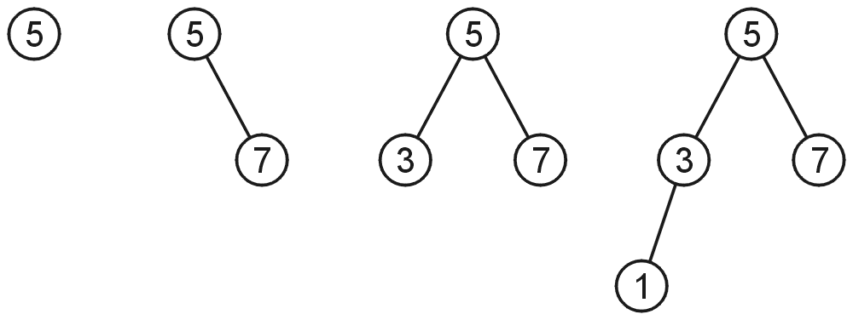
AVL Trees
AVL trees with 1, 2, 3, and 4 nodes:

Slide 4
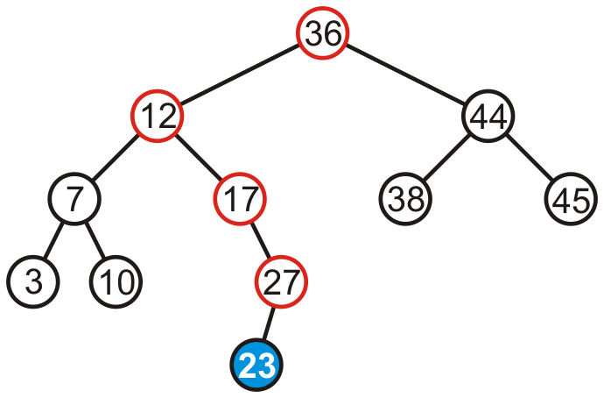
AVL tree?

Slide 5
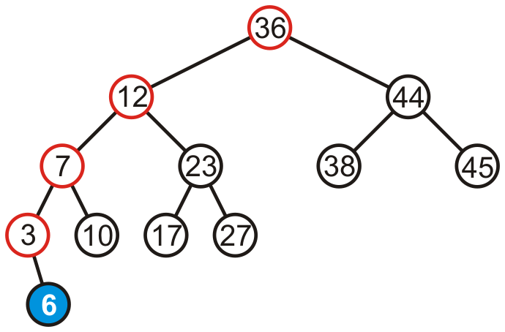
AVL tree?

Slide 6
Draw AVL trees with minimum nodes of height 2, 3 and 4

Slide 7

Height of AVL tree
Let n(h) be minimum number of nodes in an AVL tree of height h.
n(h)=n(h-1)+n(h-2)+1
Now, n(h-1) >= n(h-2)
Hence, n(h)=n(h-1)+n(h-2)+1 > 2n(h-2)
n(h) > 2n(h-2)
> 4 n(h-4) by same logic
> 8n(h-6)
……
> 2^i n(h-2i)
When i=h/2-1 we get n(h) > 2^ {h/2-1} n(2) = 2^{h/2}
Thus, h< 2 log n(h)
Thus height of AVL tree is O(log n)

Slide 8
HW:
Maximum number of nodes in an AVL tree of height h?

Slide 9
AVL Tree Example:
Insert 14, 17, 11, 7, 53, 4, 13 into an empty AVL tree

Slide 10
AVL Tree Example:
Insert 14, 17, 11, 7, 53, 4, 13 into an empty AVL tree
14
11
17
7
53
4

Slide 11
AVL Tree Example:
Insert 14, 17, 11, 7, 53, 4, 13,12, 40 into an empty AVL tree
14
7
17
4
11
53
13

Slide 12
AVL Tree Example:
Now insert 12
14
7
17
4
11
53
13
12

Slide 13
AVL Tree Example:
Now insert 12
14
7
17
4
11
53
12
13

Slide 14
AVL Tree Example:
Now the AVL tree is balanced.
14
7
17
4
12
53
11
13

Slide 15
AVL Tree Example:
Now insert 8
14
7
17
4
12
53
11
13
8

Slide 16
AVL Tree Example:
Now insert 8
14
7
17
4
11
53
8
12
13

Slide 17
AVL Tree Example:
Now the AVL tree is balanced.
14
11
17
7
12
53
4
8
13

Slide 18
AVL Tree Example:
Now remove 53
14
11
17
7
12
53
4
8
13

Slide 19
AVL Tree Example:
Now remove 53, unbalanced
14
11
17
7
12
4
8
13

Slide 20
AVL Tree Example:
Balanced! Remove 11
11
7
14
4
8
12
17
13

Slide 21
AVL Tree Example:
Remove 11, replace it with the largest in its left branch
8
7
14
4
12
17
13

Slide 22
AVL Tree Example:
Remove 8, unbalanced
7
4
14
12
17
13

Slide 23
AVL Tree Example:
Remove 8, unbalanced
7
4
12
14
13
17

Slide 24
AVL Tree Example:
Balanced!!
12
7
14
4
13
17

Slide 25
In Class Exercises
Build an AVL tree with the following values:
  15, 20, 24, 10, 13, 7, 30, 36, 25
  Remove 24 and 20 from the AVL tree

Slide 26
  15, 20, 24, 10, 13, 7, 30, 36, 25
20
15
15
24
20
10
24
13
20
20
13
24
15
24
10
15
13
10

Slide 27
  15, 20, 24, 10, 13, 7, 30, 36, 25
20
13
13
24
10
20
10
15
7
15
24
7
30
13
36
10
20
7
15
30
24
36

Slide 28
  15, 20, 24, 10, 13, 7, 30, 36, 25
13
13
10
20
10
20
7
15
30
7
15
24
24
36
30
25
13
25
36
10
24
7
20
30
15
25
36

Slide 29
  Remove 24 and 20 from the AVL tree.
13
13
10
24
10
20
7
20
30
7
15
30
15
25
36
25
36
13
13
10
30
10
15
7
15
36
7
30
25
25
36

